Slide 1


GROUP ASSIGNMENT-1 CLASSIFICATION Prof. Arya Rahgozar (GNG 5125)
Group Members:- Jayshil Patel
Josh Patel
Hrutik Champaneri
Pratik Gade

Slide 2
Dataset 1
Book name | Genre
Pride and Prejudice | Romance
Frankenstein | Horror fiction
Moby-dick | Adventure fiction
The origin of Species | Science
War and Peace | Historical
Dataset 1 Accuracy:
In most cases accuracy for our champion model was around 95%.
Dataset 2 Accuracy:
In most case accuracy for our champion model was around 91%.
Dataset 2
Book Name | Genre
Middlemarch | Romance
Hints for lovers | Romance
Falling in love | Romance
Herein is Love | Romance
The Evolution of Love | Romance

Slide 3
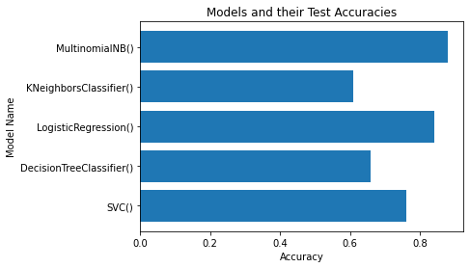
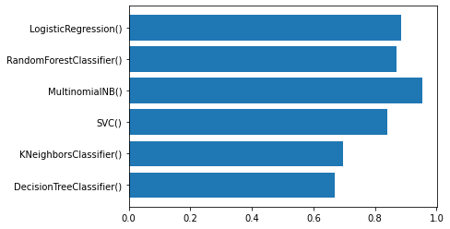
In the dataset 2 naive bias is performing best among all of them however in the second dataset there are multiple models which are having almost identical accuracies.

Slide 4
Thank You

